Slide 1
Chapter Ten
Pricing:
Understanding and Capturing Customer Value

Slide 2
What Is a Price?
It is the amount of money charged for a product or service.
It is the sum of all the values that consumers give up in order to gain the benefits of having or using a product or service.
It is the only element in the marketing mix that produces revenue; all other elements represent costs

Slide 3
Factor Need to be Considered When setting Price
Customer perception of values
    No demand above this price
Internal and external considerations
    Marketing strategy, objectives, mix
    Nature of the market and demand
    Competitors strategies and prices
Product cost
    No profit below this price

Slide 4
Customer Perceptions of Value
Understanding how much value consumers place on the benefits they receive from the product and setting a price that captures that value
    Value-based pricing
    Good-value pricing
    Value-added pricing

Slide 5
Value-based pricing
It uses the buyers’ perceptions of value, not the sellers cost, as the key to pricing. Price is considered before the marketing program is set.
Value-based pricing is customer driven
Cost-based pricing is product driven

Slide 6
Good-value pricing
Good-value pricing offers the right combination of quality and good service to fair price
Existing brands are being redesigned to offer more quality for a given price or the same quality for less price

Slide 7
Types of Good-value Pricing
Everyday low pricing (EDLP) involves charging a constant everyday low price with few or no temporary price discounts
High-low pricing involves charging higher prices on an everyday basis but running frequent promotions to lower prices temporarily on selected items

Slide 8
Value-added pricing
Value-added pricing attaches value-added features and services to differentiate offers, support higher prices, and build pricing power
Pricing power is the ability to escape price competition and to justify higher prices and margins without losing market share

Slide 9
Company and Product Costs
Set price based on company and product cost
Cost-based pricing involves setting prices based on the costs for producing, distributing, and selling the product plus a fair rate of return for its effort and risk
adds a standard markup to the cost of the product

Slide 10
Types of company and product Costs
1) Fixed costs are the costs that do not vary with production or sales level
    Rent
    Interest
    Executive salaries
2) Variable costs are the costs that vary with the level of production
    Packaging
    Raw materials
3) Total costs are the sum of the fixed and variable costs for any given level of production
4) Average cost is the cost associated with a given level of output

Slide 11
Cost at different levels of production
    To price wisely, management needs to know how its costs vary with different levels of production.
Costs as a Function of Production Experience
    Experience or learning is when average cost falls as production increases because fixed costs are spread over more units

Slide 12
Cost-Plus Pricing
Cost-plus pricing adds a standard markup to the cost of the product
Benefits
  Sellers are certain about costs
  Prices are similar in industry and price competition is minimized
  Consumers feel it is fair
Disadvantages
  Ignores demand and competitor prices

Slide 13
Break-Even Analysis and Target Profit Pricing
Break-even pricing is the price at which total costs are equal to total revenue and there is no profit
Target profit pricing is the price at which the firm will meet break even or make the profit it’s seeking

Slide 14
Other Internal and External Considerations Affecting Price Decisions
Companies must consider internal and external factors when setting prices
1) Overall marketing strategy, objectives and mix
    Target costing starts with an ideal selling price based on consumer value considerations and then targets costs that will ensure that the price is met
2) Organizational considerations include
    Who should set the price
    Who can influence the prices

Slide 15
The Market and Demand
Before setting prices, the marketer must understand the relationship between price and demand for its products
Types of Markets
    Pure competition
      Many buyers and sellers
    Monopolistic competition
      Sellers are differentiate their product
    Oligopolistic competition
      Few sellers, they are highly sensitive to each other pricing and marketing strategies
    Pure monopoly
      Only one seller

Slide 16
The Market and Demand
The demand shows the number of units the market will buy in a given period at different prices
Normally, demand and price are inversely related
Higher price = lower demand
For prestige (luxury) goods, higher price can equal higher demand when consumers perceive higher prices as higher quality

Slide 17
Other Internal and External Considerations
Price elasticity of demand illustrates the response of demand to a change in price
  Inelastic demand occurs when demand hardly changes when there is a small change in price
  Elastic demand occurs when demand changes greatly for a small change in price
Price elasticity of demand = % change in quantity demand
% change in price

Slide 18
Other Internal and External Considerations
Competitor's Strategies
Comparison of offering in terms of customer value
Strength of competitors
Competition pricing strategies
Customer price sensitivity

Slide 19
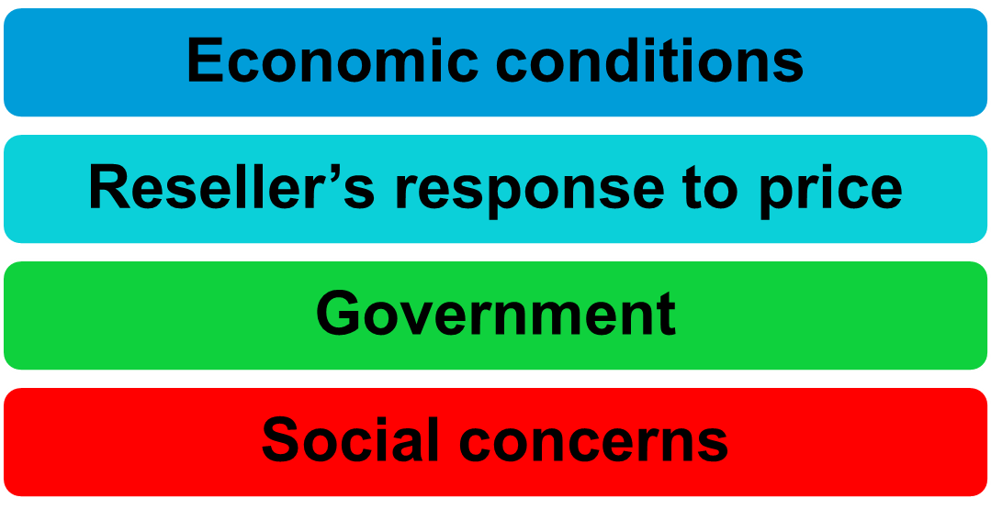
Other Internal and External Consideration

